Slide 1
Justice and Civilized Humanity Session 07
Course : CB Pancasila
Effective Period : 2017

Slide 2
Student will be able to explain and apply the humanity values in social action
Learning Objectives

Slide 3
The Nature of Humanity
1). Human have soul and body
2). Human as autonomy subject
3). Human as relational subject;
God
Others
Environment

Slide 4
Justice and Civilized Humanity
1). Recognize and treat people according to their status and dignity as creatures of God Almighty
2). Recognizes equality, fundamental rights and obligations of every human being, regardless of race, ethnicity, religion, creed, sex, skin color, and etc

Slide 5
3). Develop mutual love amongst human
4). Develop a taste and considerate tolerance attitude
5). Float attitude arbitrarily against others
6). Uphold humanity values
7). To implement the humanity values in our lives

Slide 6
8). Dare to stand for truth and justice
9). Indonesian nation as a part of the whole human race
10). Develop an attitude of respect to other nations.

Slide 7
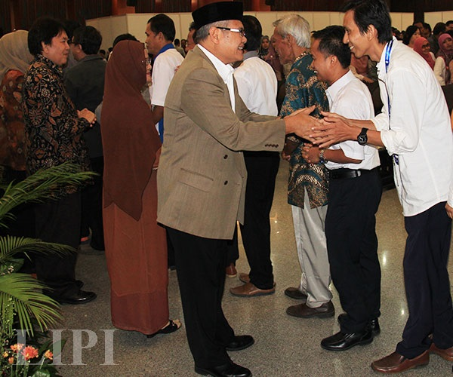
Ethical Relationship among Humans
1). Ethical relationships
2). Good Attitude Principle
3). Principle of Respect for Others
4). Share with Others

Slide 8
Discussion
Do you think Justice and Civilized Humanity applied in Indonesia?
Please descript your answer?

Slide 9
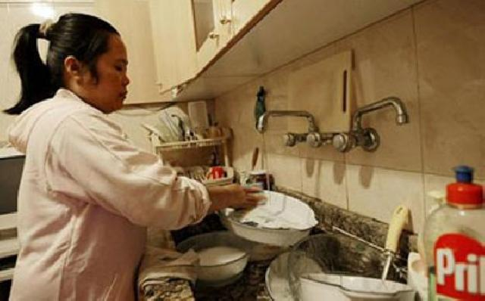
Case study
Read the article based on the following link ….
And give your opinion
Modern slavery with
discrimination
domestic workers
http://www.netralnews.com/news/kesra/read/26867/perbudakan.modern.dengan.diskriminasi.pembantu.rumah.tangga

Slide 10
Question and Answer
?

Slide 11
References
Tim Penulis CB: Pancasila (2014). Diktat Kuliah Character Building: Pancasila. Binus University: CBDC, 000
Kesamaan derajat warga negara: http://bassmotion.tumblr.com/post/39846424551/kesamaan-derajat-warga-negara
Gambar orang berjabat tangan: http://lipi.go.id/berita/Halal-bihalal-Keluarga-Besar-LIPI-Hubungan-Positif-Bantu-Tingkatkan-Kinerja-Lembaga/15799
Gambar dan artikel : http://www.netralnews.com/news/kesra/read/26867/perbudakan.modern.dengan.diskriminasi.pembantu.rumah.tangga

